Slide 1
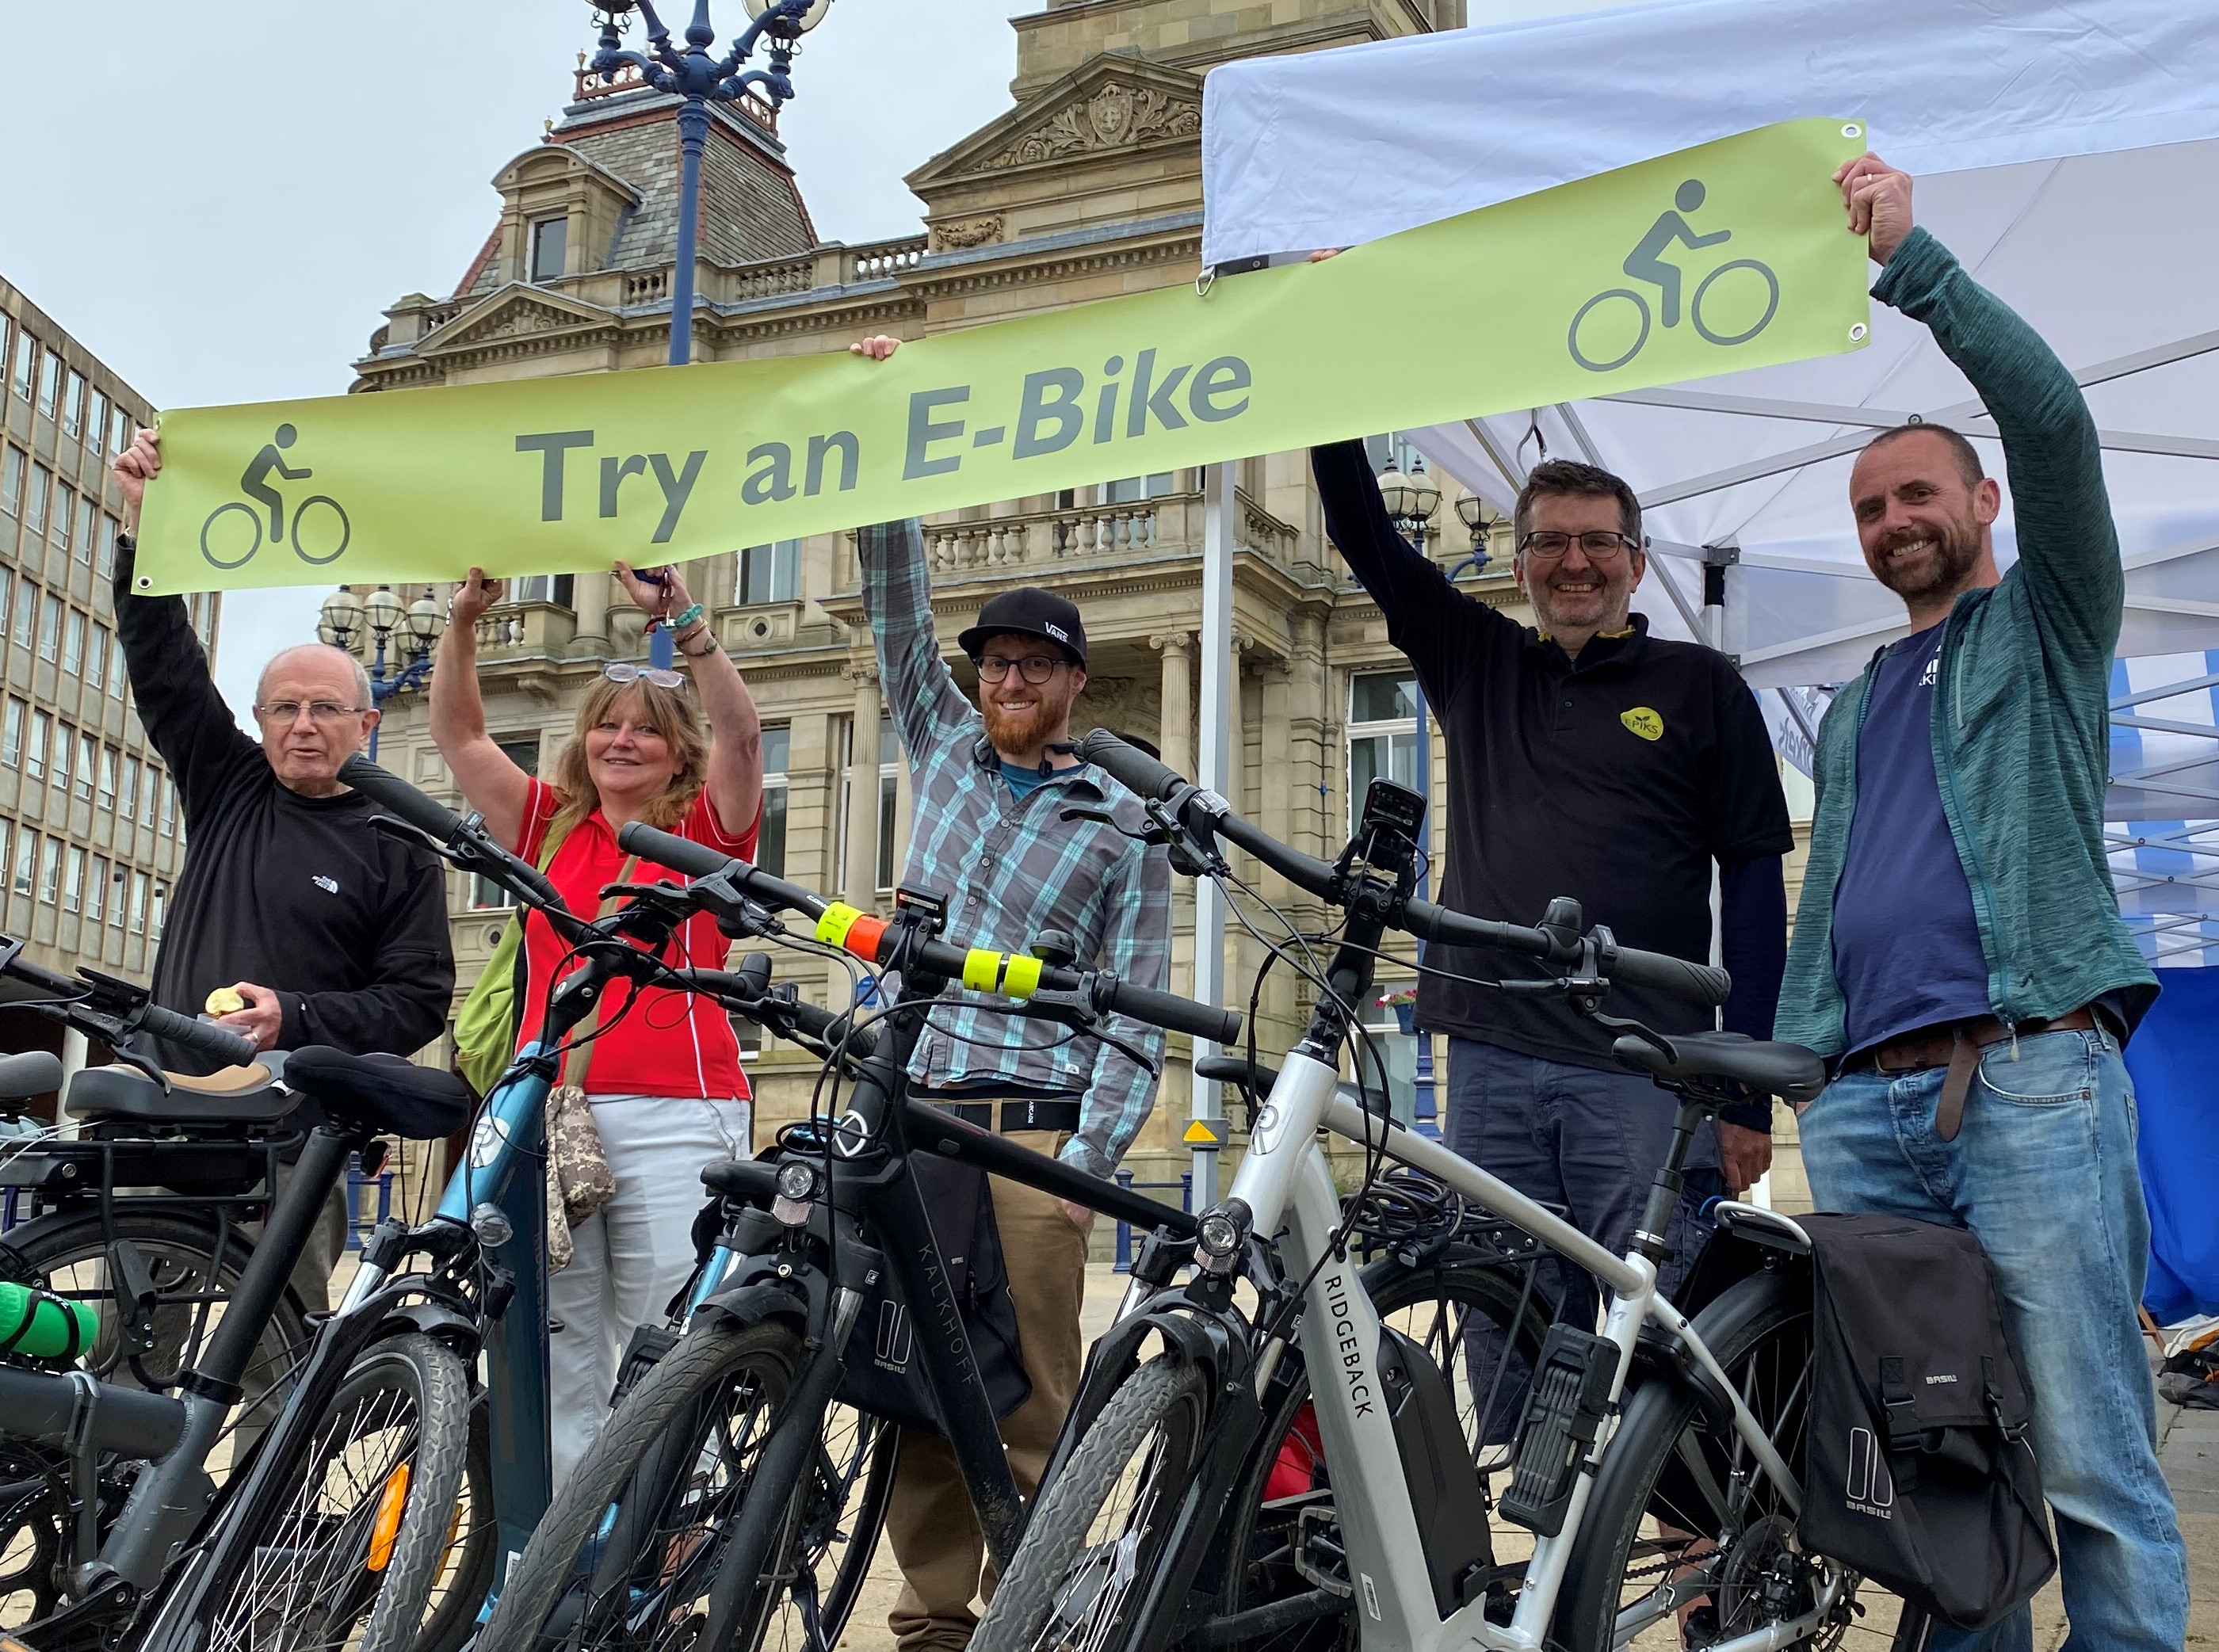


Try an e-bike
An opportunity for your staff to try an e-bike including safety equipment, risk assessments and a qualified instructor

Slide 2
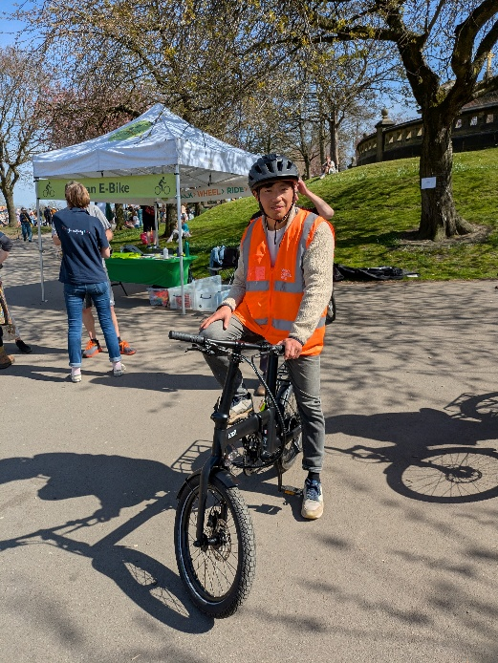
WWR ‘Try an e-bike’ events
EPIKS is providing an opportunity for employees at local businesses to test out pedal-assist e-bikes as part of its Walk, Wheel, Ride programme which promotes the use of active travel within Kirklees.
EPIKS has a range of e-bikes of different sizes and designs, available for test-riding. We provide a qualified trainer who will help you decide whether to take a quick spin in a safe space nearby or a longer, pre-planned 30-minute ride* incorporating a range of terrains which covers 2-3 miles. The whole process of introduction, Q&A and instruction takes around one hour. The routes we choose incorporate a few hills to get a flavour of how fun and versatile e-bikes are (and don’t make you arrive at your destination in a lather!). We’ll also provide some information on the best places to buy e-bikes, how to get the right one for you and keep it well maintained. Each hour-long session has a capacity for five riders and we usually suggest offering four rides per day.
What we provide
Tailored routes, risk assessed, over mixed terrain (2-3 miles).
A fully qualified instructor
5 low mileage, high quality, e-bikes
Bikes fully maintained by Oakwell Cycles mechanic
Further advice and information: e.g. locks, carrying equipment, helmets etc
Public liability insurance and ride insurance provided through Cycling UK
An e-van and gazebo for transportation and display
Tailoring sessions to suit your staff
All sessions can be tailored to suit the needs of your staff and the capacity they have on the day. If shorter sessions are required, we suggest opting for quick ‘have a go’ sessions or ‘show and tell’ sessions and the timing can be reduced accordingly.
*Riders will be assessed for safety and competence before trying an e-bike

Slide 3

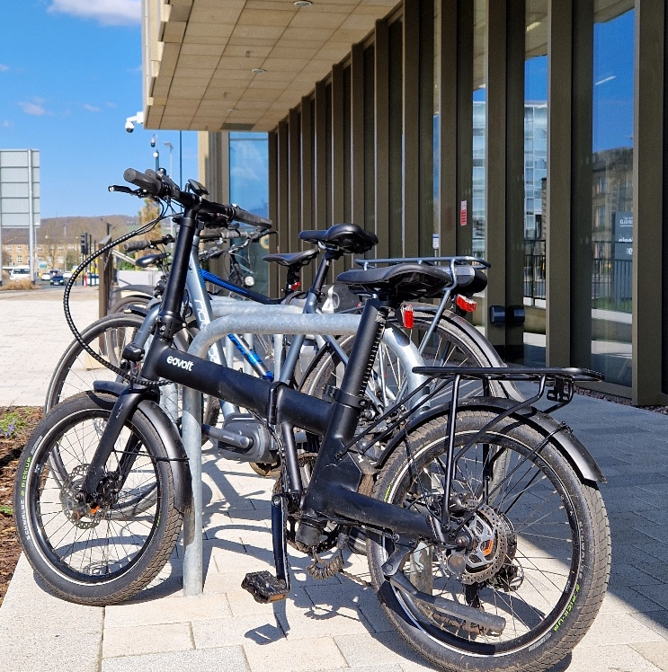
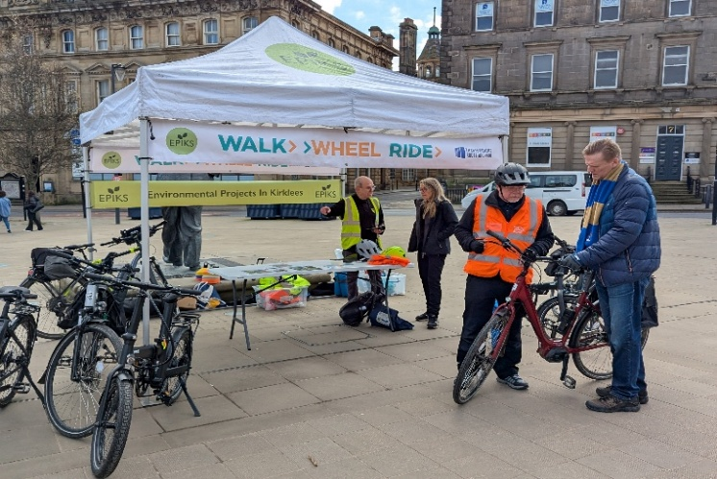
Show and Tell Events
EPIKS can provide a show and tell pop-up stall where staff will provide all the key information on areas like how to buy an e-bike, what sort of things to consider, e-bike storage and safety. This gives clients a chance to look at a variety of bikes and have their questions answered.
What we provide
A range of e-bikes to demonstrate the variety available.
Advice on purchasing e-bikes and useful information of cycle-to-work schemes.
Further advice and information on locks, carrying equipment, helmets etc
Information on cycling routes, apps to help plan rides and local adult bike confidence courses.
An e-van and gazebo for transportation and display
Information that suits you
All show and tell pop-up events can be tailored to suit your needs. Please speak to us if you require specific information or signposting.

Slide 4
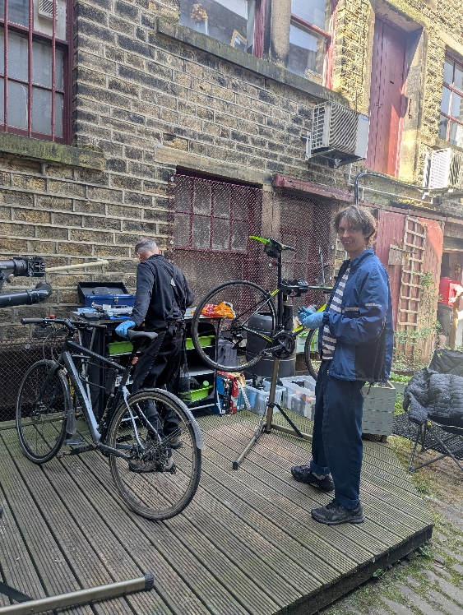
Dr Bike Workshops
In these 30 minute Dr Bike checks a mechanic will check everything on your bike from wheels, brakes, gears and tyre pressure to lights, racks, pedals, saddles and more. They can make any minor adjustments to the bike there and then. If there’s anything they can't fix on site, they will let you know exactly what needs doing and a rough guide to what it should cost at a bike shop. All recommendations will be recorded so customers can go away feeling confident they have the information they need.
EPIKS has a history of successful Dr Bike workshops with many happy customers who now feel more confident about using their bikes safely.
What we provide
A qualified mechanic
Two members of the EPIKS team to support sign in and maintenance advice
A full assessment of the bike, including written feedback of recommendations
Small adjustment and fixes
Advice and support on how much any major issues will cost and the best places to take them
Public liability insurance
All equipment required for assessments, fixes and running of the workshop
Tailoring sessions to suit your staff
The length of Dr bike sessions can be tailored to suit your organisations needs and depending on the number of bikes required to accommodate. Please note that we do not include secure bike parking as part of the package. However there will be a member of staff present throughout the session time.

